Slide 1
Hand Gesture Recognition Using CNN and OpenCV
By Ditsa Pandey

Slide 2
Contents
Introduction
Problem Statement
Objective
Related Work
Implementation
Summary
Conclusion

Slide 3
Introduction
Hand Gesture Recognition plays a pivotal role in using various applications ranging from using sign language, virtual reality, gaming and many more.
Imagine being able to communicate with different devices and applications just by hand gesturing we will be able to have immersive experience and better accessibility.
Recognizing the hand gestures accurately bring its own set of challenges. Factors like :
variability in hand shape and size
Lighting conditions
Visibility and understanding of the problem.

Slide 4
Problem Statement
To work on the factors of Hand Gesture Recognition to understand and to get better accuracy for prediction.
The main objective is to develop Hand Gesture Recognition system using Convolutional Neural Network(CNN) and OpenCV.
The dataset was collected and preprocessing.
Designing and training of model using CNN.
Real-time gesture recognition using OpenCV.
Objective

Slide 5
Related Work
Data Definition:
the dataset comprises of set of near infrared images acquired by the Leap motion sensors.
The database is composed by 10 different hand gestures that were performed on different subjects(men and women).
The dataset was segmented in different files and image classification was performed.

Slide 6
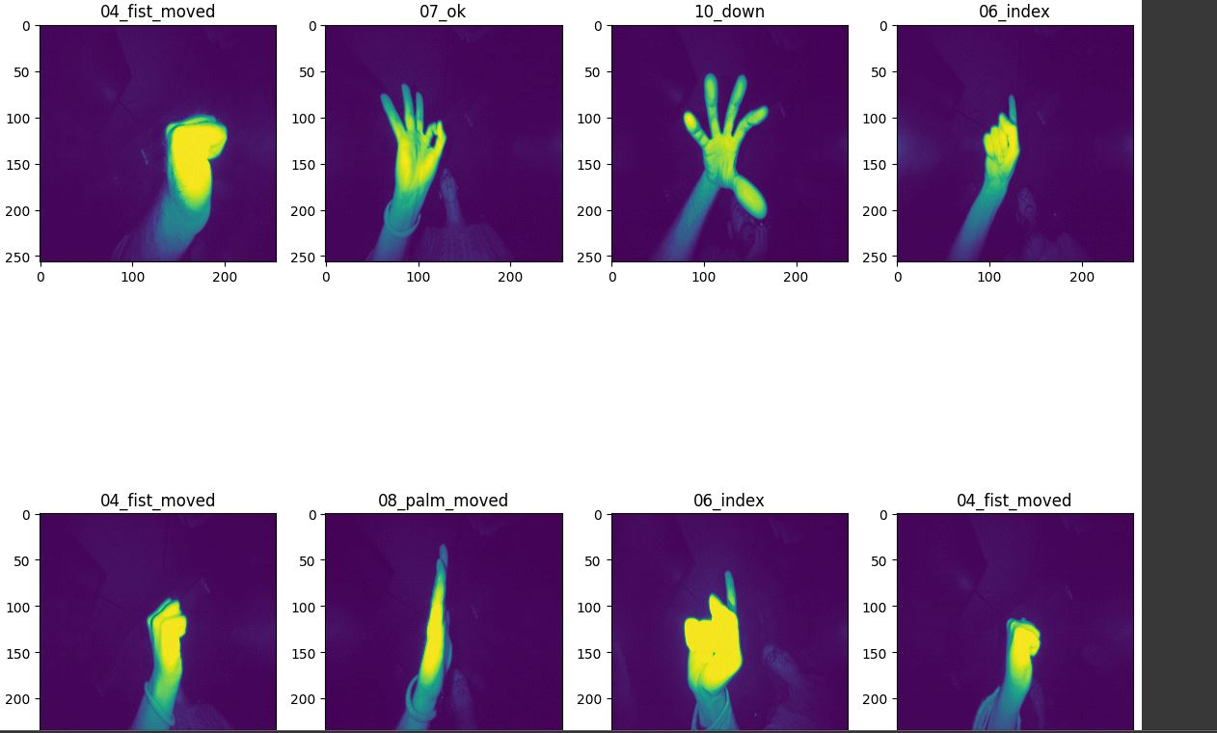
Implementation
1. Data collection and preprocessing
Dataset was collected from Kaggle.
Preprocessing consists of classification of different gestures accordingly.
Classification of the images as a part of preprocessing

Slide 7
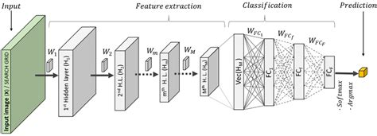
2. Cnn model design and training
The model was Sequential and Convolutional 2D layer were used.
Training data and testing data were taken in 75:25 ratio.
Activation function for hidden layer used is ‘relu’ and for output layer is ‘softmax’
CNN Architecture

Slide 8
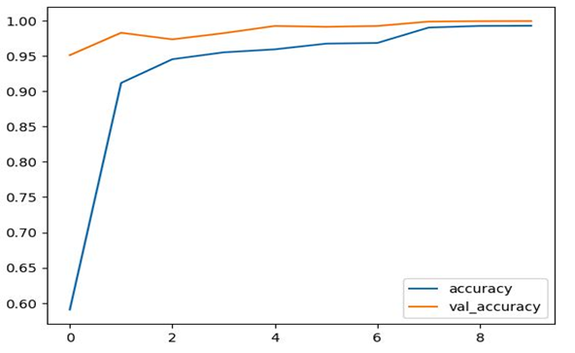
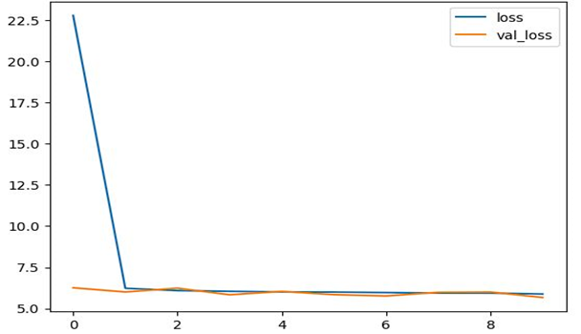
Accuracy and Loss plot by CNN Model
3. Real-time gesture recognition using opencv
The pretrained model was used for real- time gesture recognition.

Slide 9
Summary & Conclusion
The Hand Gesture recognition project has a real time impact using OpenCV.
It would enhance the accuracy and adaptability to various different conditions in the real-world applications that can help humans and machine interaction more accessible.
The current model worked on 10 different gestures, however, in future multiple gestures could be used for more intuitive human-computer more intuitive.
Future Work:
To Blur the background in real-time application and create a threshold region.
To include other commonly used hand-gestures in the model.
To reduce the lag-time in OpenCV.
Include video in real-time application.

Slide 10
References
iopscience.iop.org
pub.aimind.so
https://www.tensorflow.org/api_docs/python/tf/keras/applications/vgg16/VGG16
www.kaggle.com
https://github.com/

Slide 11
Thank You

